Slide 1
Home Credit Default risk
Technical presentation
Tri Nguyen
May 18, 2020
https://github.com/ntdtri/Home-Credit-Default-Risk

Slide 2
Credit default 8%, ~2% over market average. Need to understand how to better target low-risk customers?
Unbanked populations with limited credit history
Credit default at 8%
Losing customers
Core customers are unbanked and limited credit history, which made it difficult to predict the repayment ability.
Credit default is 2% above market, which caused difficulties in cashflow and increases in operation costs.
Home Credit loss 5% of the customers in the last 12 months. The company could not maintain a good inflow of low-risk customer due to its competitive rates.

Slide 3
Combining data from multiple sources, using descriptive and Inferential statistics, we discovered the variables that are highly related to default rate.
What opportunities exist for Home Credit to expand their market but reduce its default rate by 2% in the next 12 months.
Descriptive Statistics
Inferential Statistics

Slide 4
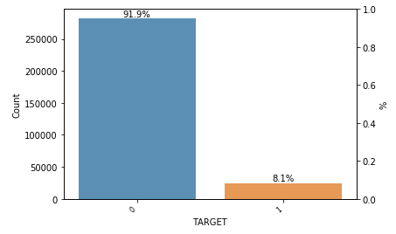
Data overview
307,511 entries
8% default rate
Combines from 3 databases
Application data
Info about loan and applicant at the application time
SK_ID_CURR
SK_ID_CURR
Bureau
Previous Application
Loans reported to Credit Bureau
Application data of client’s previous loans in Home Credit

Slide 5
Descriptive statistics
What do some features tell us about default risk?

Slide 6
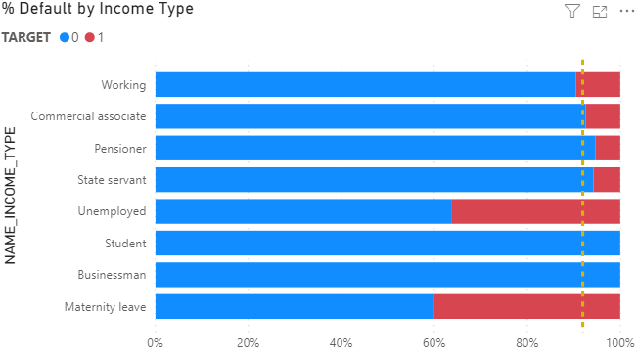
THERE IS HIGHER RISK OF DEFAULT FOR TEMPORARY NON-ACTIVE INCOME…
Students and Businessman have low default rate
Source: Application_test.csv
Unemployed and Maternity leave have higher default rate
* Income type cannot be the only factor to deny loan applications

Slide 7
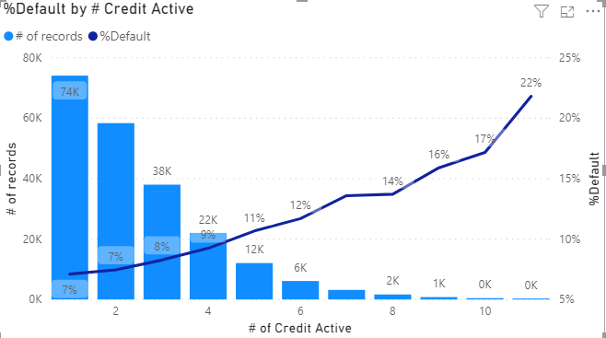
1-2% HIGHER CHANCE OF DEFAULT BY EVERY ADDITIONAL ACTIVE CREDIT
The higher the applicant’s number of credit actives, the higher the default rate.

Slide 8
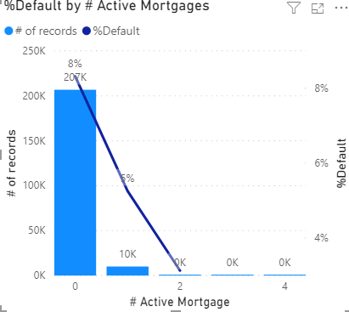
…, But # OF ACTIVE MORTGAGE trends the opposite direction…
3% drop in default risk by having 1 mortgage
0% default when having at least 2 mortgages. (Note: of samples are low for data with at least 2 mortgages)

Slide 9
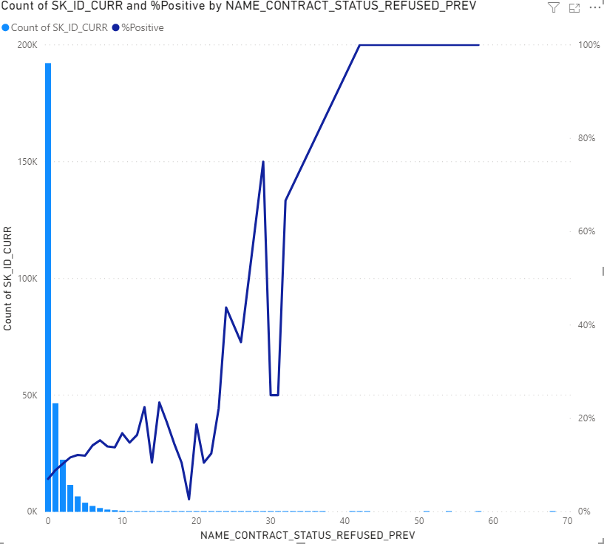
Default risk is positively correlated with # previously refused applications
Only 0-rejected applications have below average default rate (7%).
1-2% chance of default per each additional previously-rejected applications
# of samples is low, but % default still continues trending up

Slide 10
Inferential Statistics
Reduce noise and avoid overfitting…

Slide 11
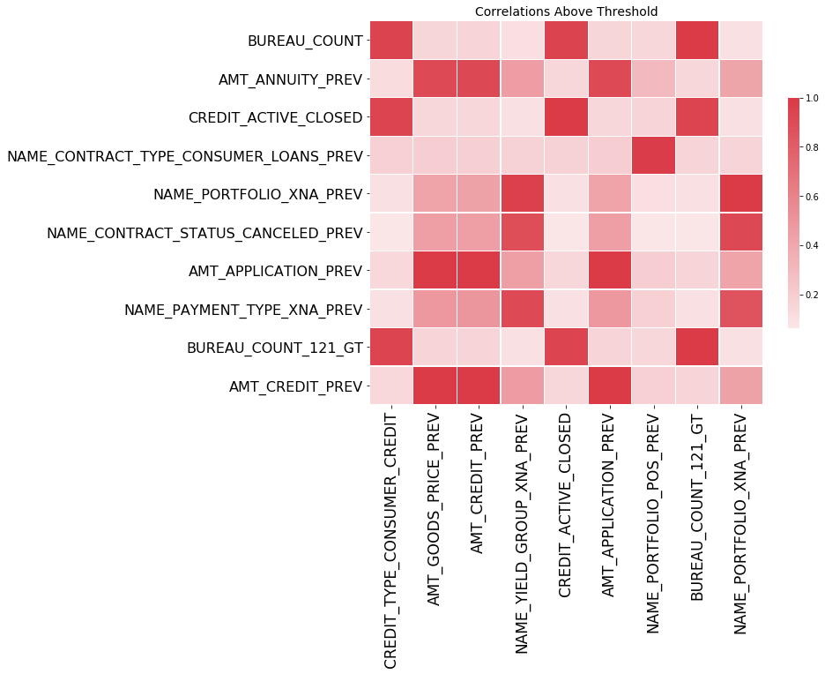
9 COLLINEAR FEATURES are removed from the dataset
Out of 64 considered features from 3 datasets, 9 collinear features that have correlation score >0.9 with others.
To be removed from the dataset

Slide 12
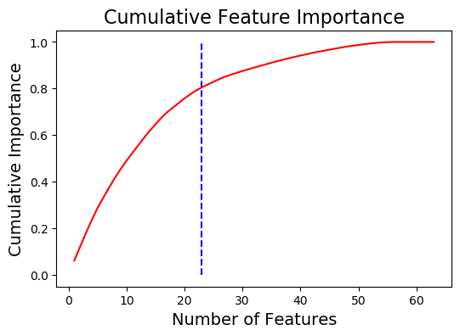
Possible to select around 20 features for future machine learning
Sum of normalized importance scores of just over 20 top features is 0.8.
Possible to narrow down to manageable # of features for future machine learning.

Slide 13
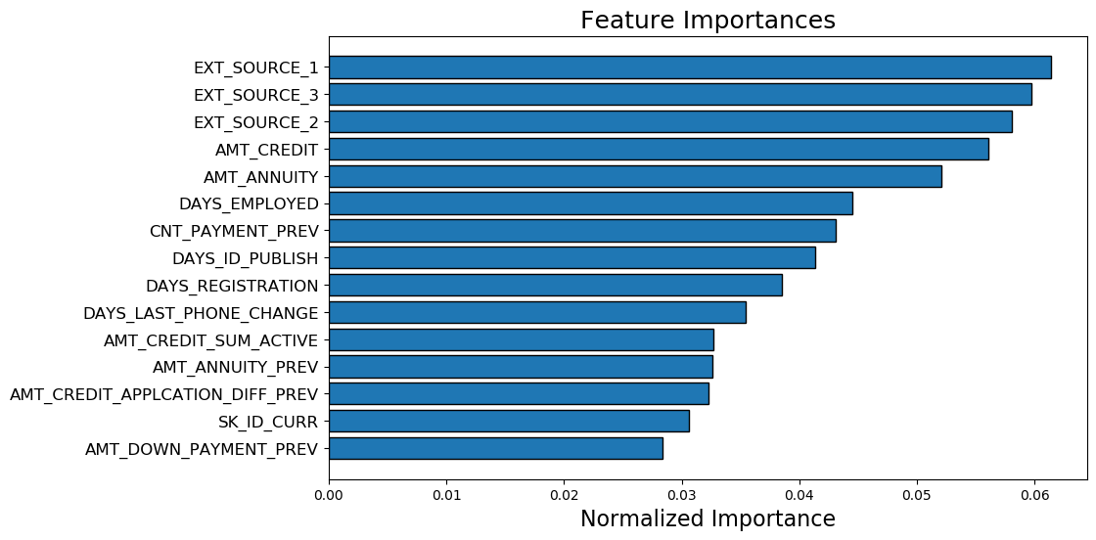
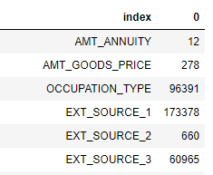
Important features are from all 3 datasets. Need a better way to fill out missing values.
# missing values
External normalized credit score are very important. However, over 50% records miss EXT_SOURCE_1 values.
Need a prediction model to fill in missing values in EXT_SOURCE

Slide 14
Current results & next steps
Current results
Accuracy
Next steps
Prediction model for EXT_SOURCE features
Recall Score
Precision score
Finetune the model
0.70
0.2
0.74
Explore other datasets

